Slide 1
MCB 3421 computer lab 14

Slide 2
student evaluations
Please follow this link to the on-line surveys
that are open for you this semester.
If you are done, check the American Gut project at
http://humanfoodproject.com/americangut/

Slide 3
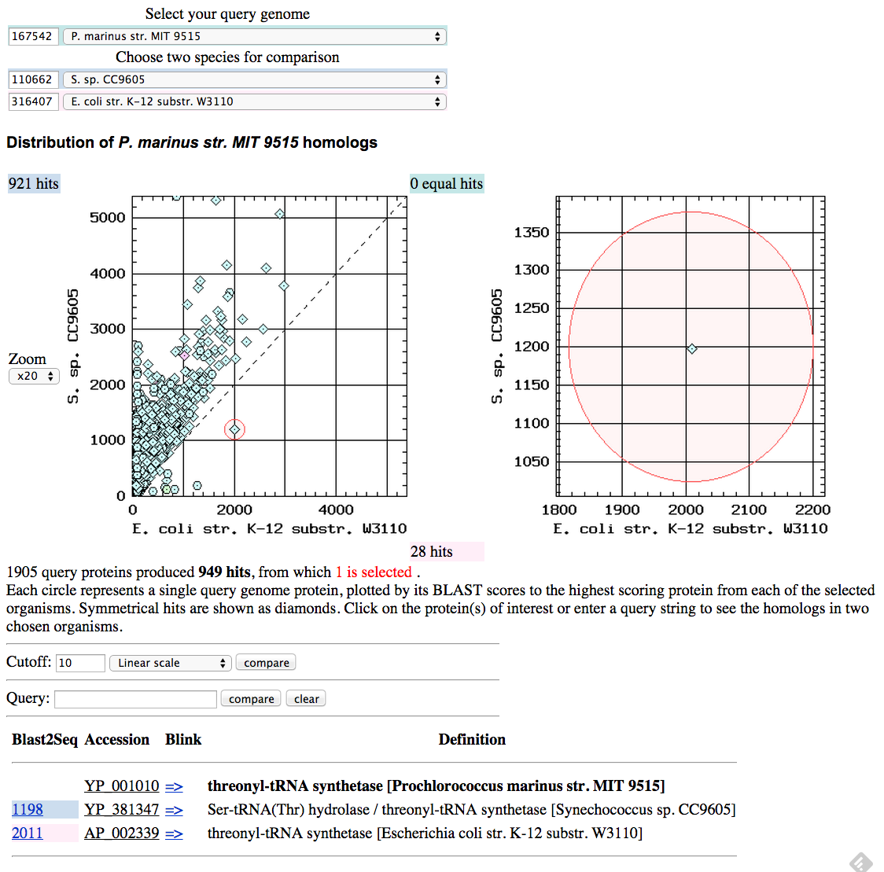

Slide 4
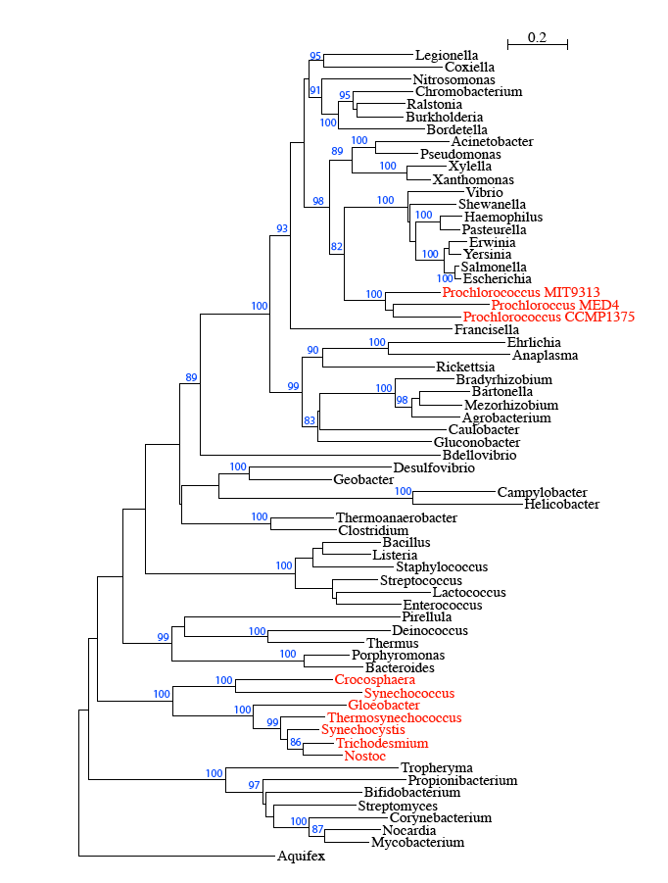
Example of inter-phylum transfer: threonyl tRNA synthetase

Slide 5
ThrRS Phylogeny – γ-Proteobacteria
Outgroup (β-Proteobacteria)
Enterobacteriales
Xantho- and
Pseudomonadales
HTCC5015
marine γ-proteobacterium
(Sargasso Sea)
Oceanospirillales
high light
low light
Notes:
Grouping of prochlorococcus with planctonic marine open ocean gamma suggest that the transfer took place in the open ocean environment, before the divergence of the different prochlorococci, and after the divergence from Synecchococci, the other group of small marine cyanobacteria.

Slide 6
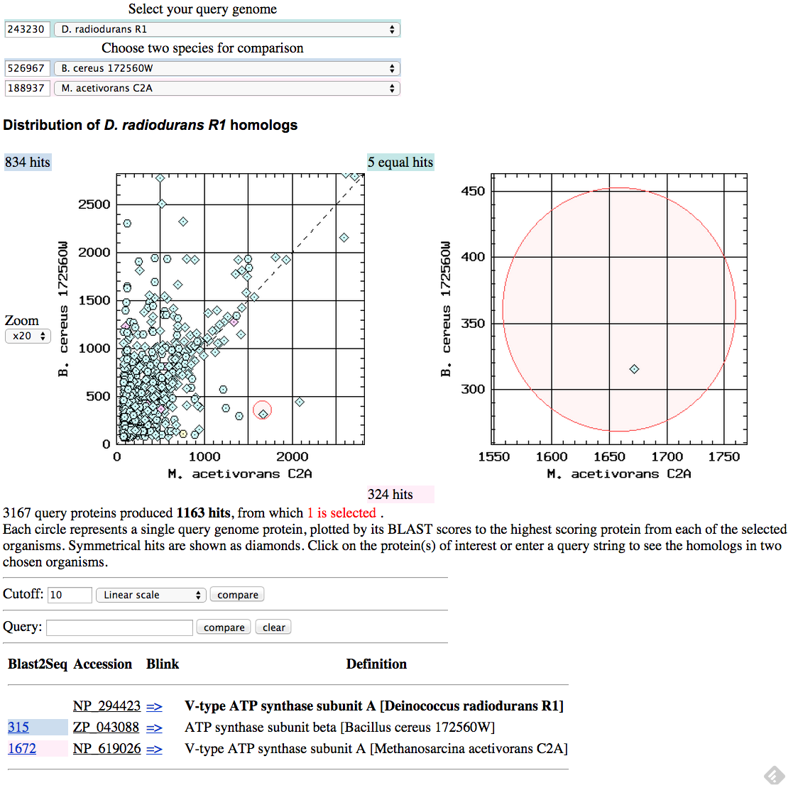

Slide 7
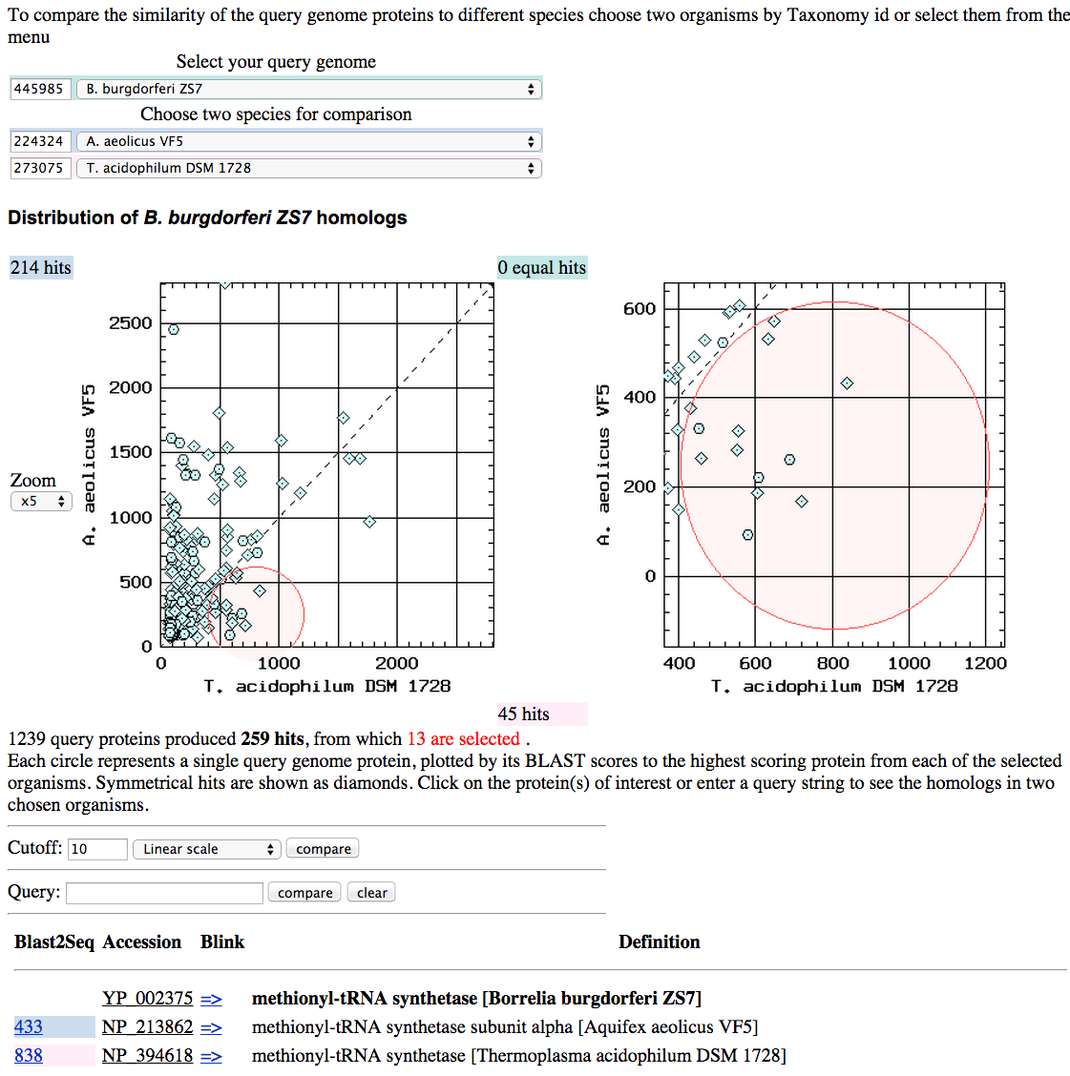

Slide 8
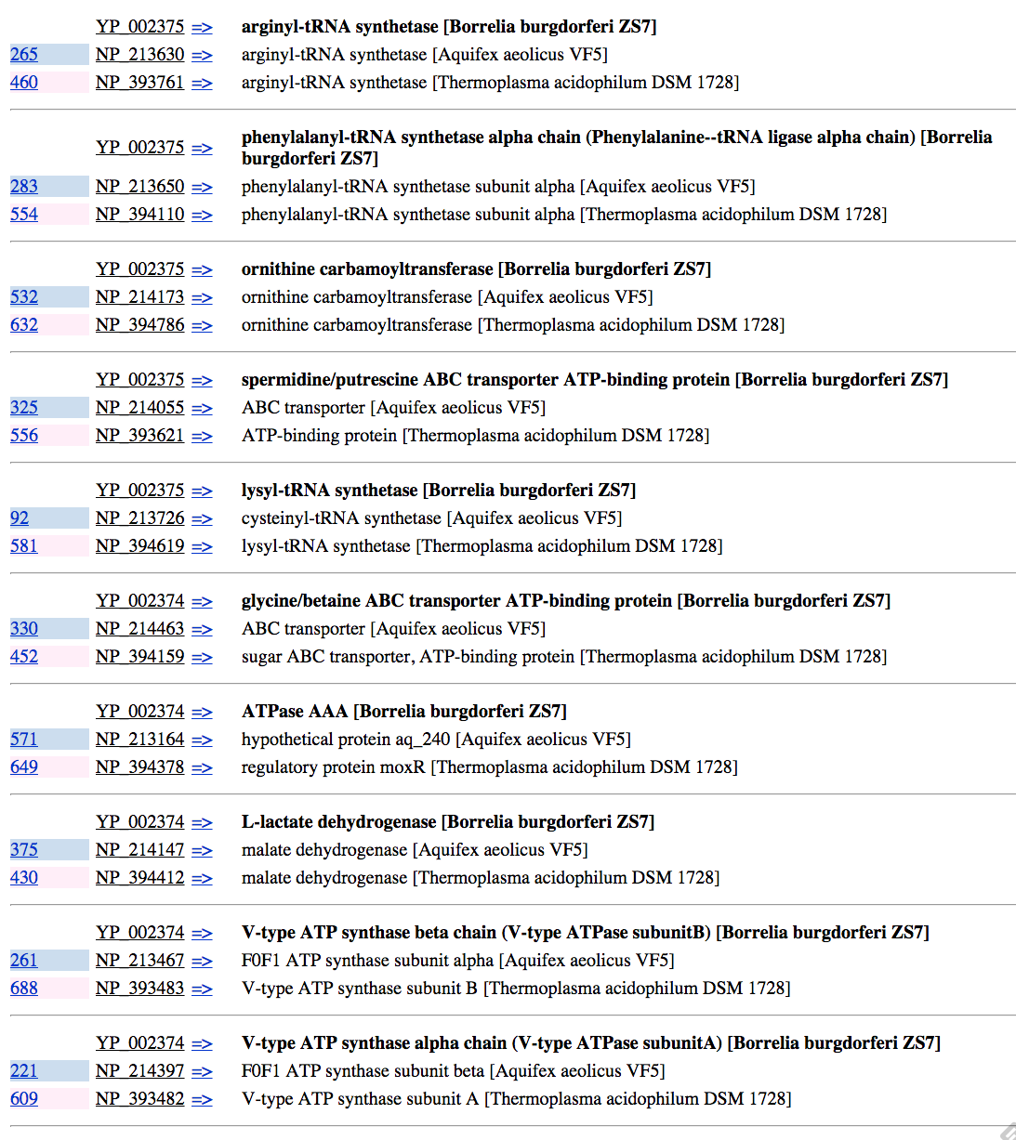

Slide 9
Histogram of theoretical isoelectric points of E. coli proteins
pH at which protein has no charge

Slide 10
Histogram of theoretical isoelectric points of Haloferax proteins
pH at which protein has no charge

Slide 11
Histogram of theoretical isoelectric points of Thermplasmatales proteins
pH at which protein has no charge

Slide 12
Histogram of theoretical isoelectric points of Saccharomyces proteins
pH at which protein has no charge

Slide 13
Histogram of theoretical isoelectric points of Chlamydomonas proteins
pH at which protein has no charge

Slide 14
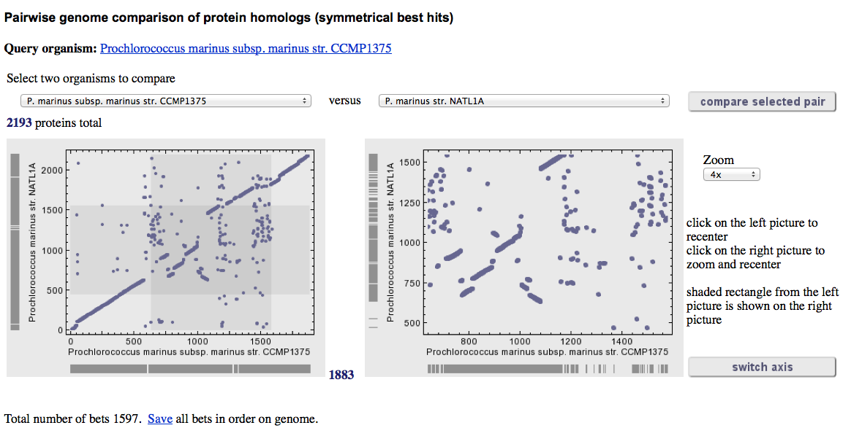

Slide 15
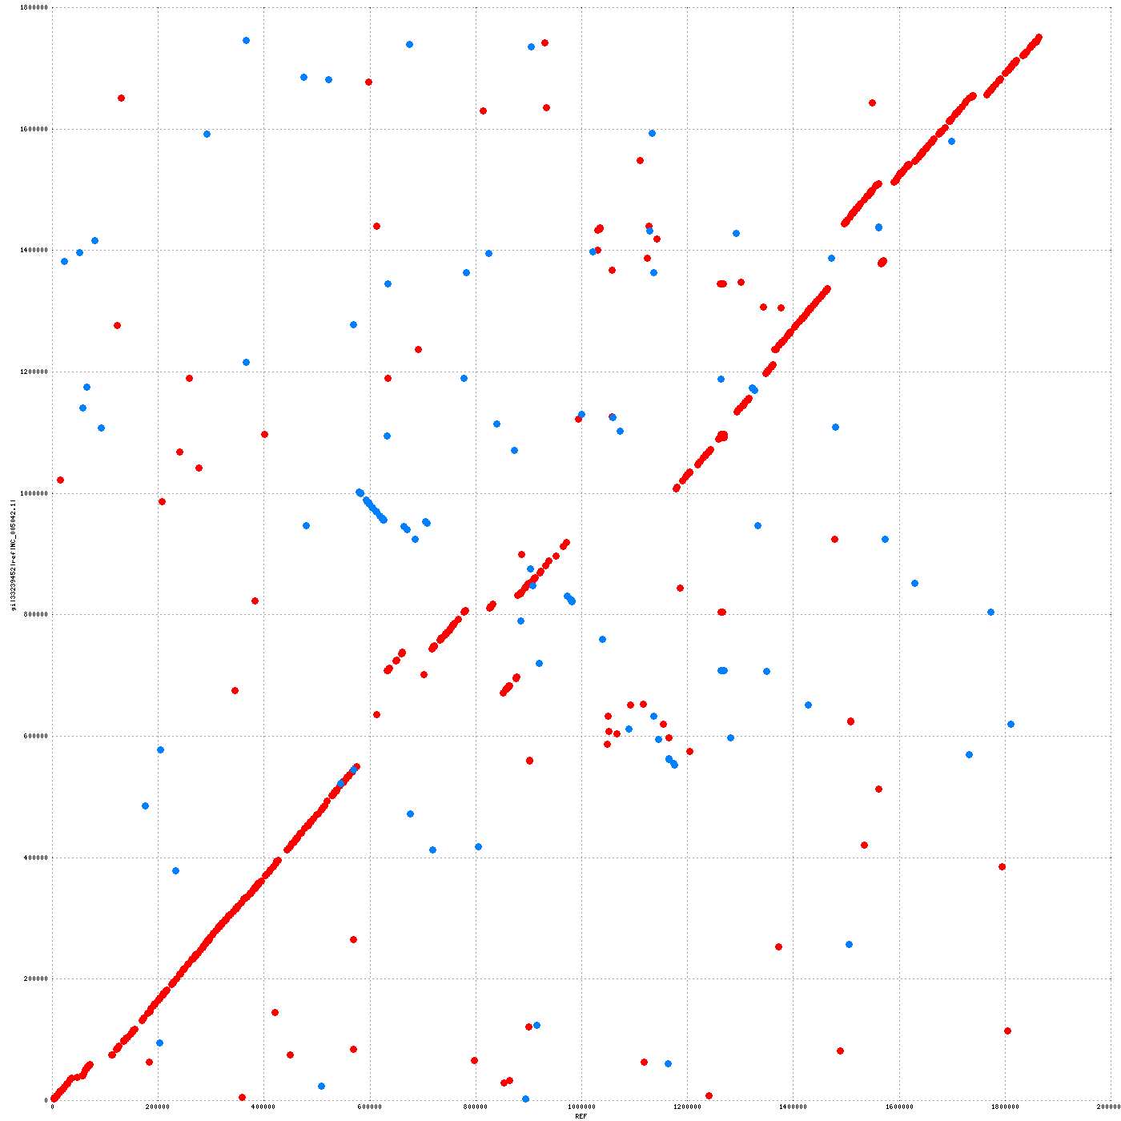
Same with mummer
using defaults

