Slide 1

Bayes’ Theorem
Likelihood
describes how well the model predicts the data
P(data|model, I)
P(model|data, I) = P(model, I)
P(data,I)
Posterior
Probability
represents the degree
to which we believe a given model accurately describes the situation
given the available data and all of our prior information I
Prior
Probability
describes the degree to which we believe the model accurately describes reality
based on all of our prior information.
Normalizing
constant
Reverend Thomas Bayes (1702-1761)

Slide 2
Alternative Approaches to Estimate
Posterior Probabilities
Bayesian Posterior Probability Mapping with MrBayes
(Huelsenbeck and Ronquist, 2001)
Problem:
Strimmer’s formula
L_{i}
p_{i}=
only considers 3 trees
(those that maximize the likelihood for
the three topologies)
L₁+L₂+L₃
Solution:
Exploration of the tree space by sampling trees using a biased random walk
(Implemented in MrBayes program)
Trees with higher likelihoods will be sampled more often
N_{i}
p_{i}≈
N_{total}
,where N_{i} - number of sampled trees of topology i, i=1,2,3
N_{total} – total number of sampled trees (has to be large)

Slide 3
Illustration of a biased random walk
Image generated with Paul Lewis's MCRobot
Figure generated using MCRobot program (Paul Lewis, 2001)

Slide 4
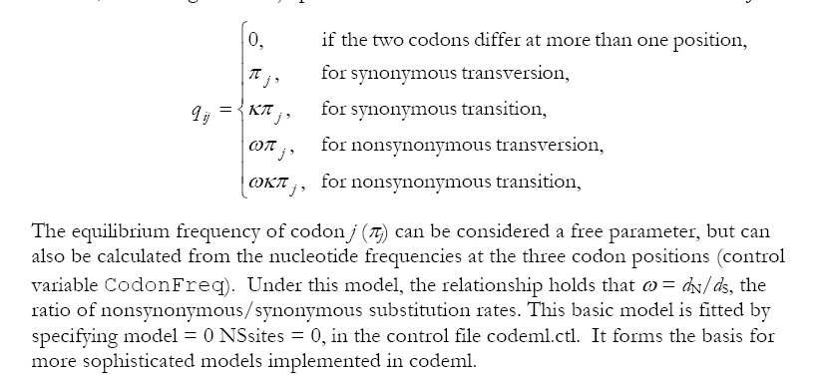
PAML (codeml) the basic model

Slide 5

sites versus branches
You can determine omega for the whole dataset; however, usually not all sites in a sequence are under selection all the time.
PAML (and other programs) allow to either determine omega for each site over the whole tree, ,
or determine omega for each branch for the whole sequence,
.
It would be great to do both, i.e., conclude codon 176 in the vacuolar ATPases was under positive selection during the evolution of modern humans – alas, a single site does not provide much statistics ….

Slide 6
Sites model(s)
work great have been shown to work great in few instances.
The most celebrated case is the influenza virus HA gene.
A talk by Walter Fitch (slides and sound) on the evolution of
this molecule is here .
This article by Yang et al, 2000 gives more background on ml aproaches to measure omega. The dataset used by Yang et al is here: flu_data.paup .

Slide 7
sites model in MrBayes
The MrBayes block in a nexus file might look something like this:
begin mrbayes;
set autoclose=yes;
lset nst=2 rates=gamma nucmodel=codon omegavar=Ny98;
mcmcp samplefreq=500 printfreq=500;
mcmc ngen=500000;
sump burnin=50;
sumt burnin=50;
end;

Slide 8
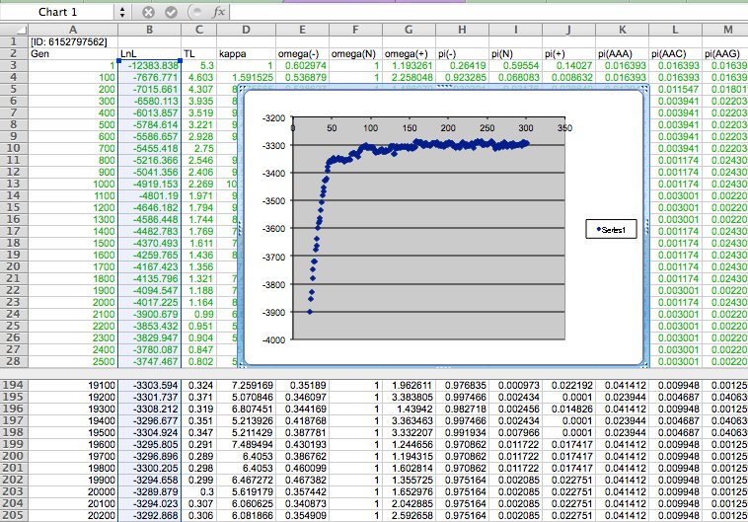

Slide 9
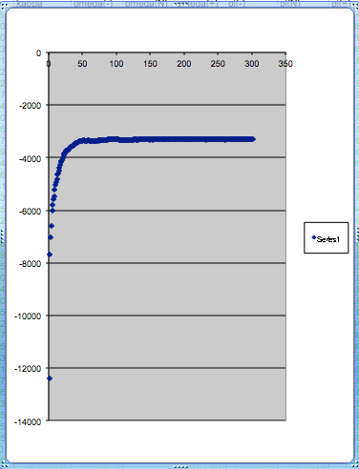
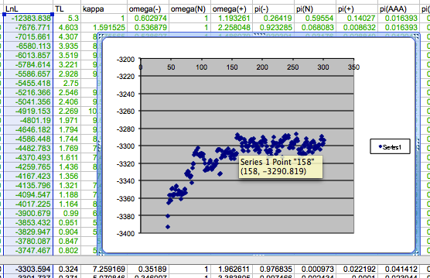
plot LogL to determine which samples to ignore
the same after rescaling the y-axis

Slide 10
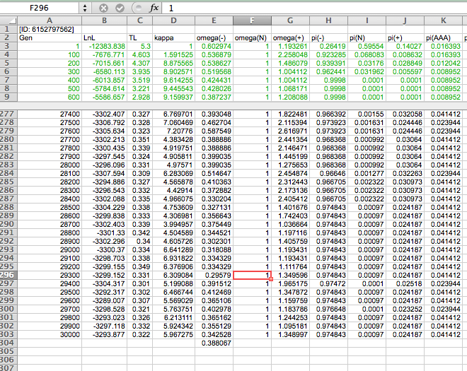

Slide 11
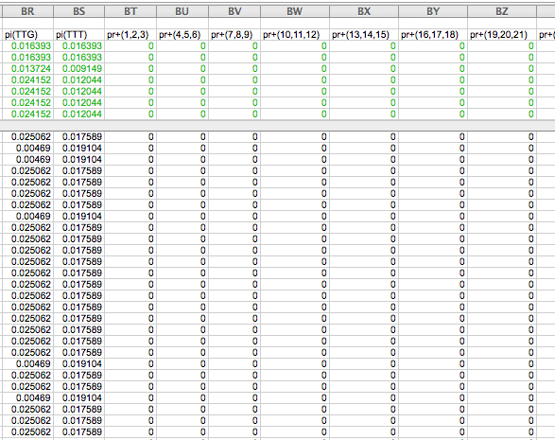

Slide 12
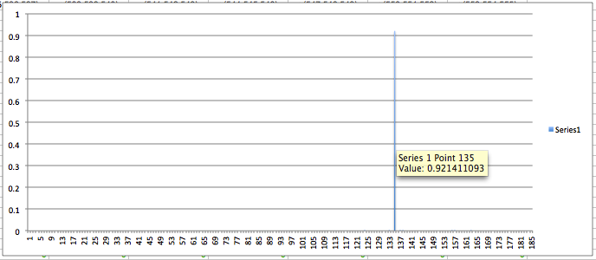
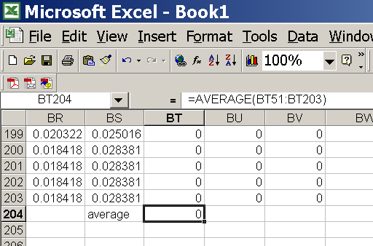
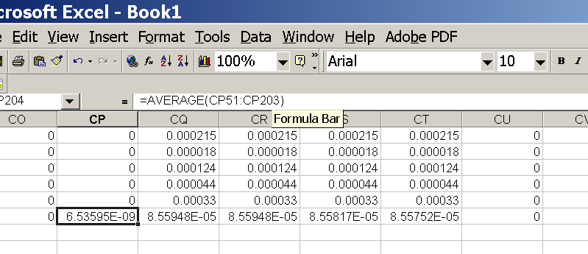
for each codon calculate the the average probability
copy paste formula
plot row
enter formula
Nucleotides 403,404,405

Slide 13
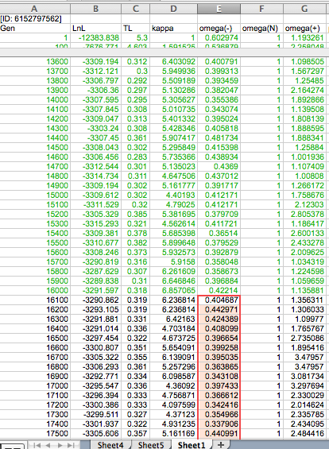
To determine credibility interval for a parameter (here omega<1):
Select values for the parameter, sampled after the burning.
Copy paste to a new spreadsheet,

Slide 14
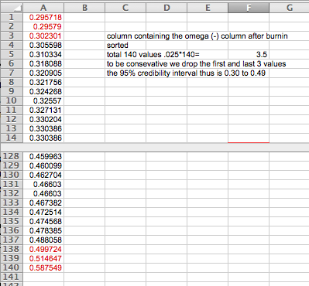
Sort values according to size,
Discard top and bottom 2.5%
Remainder gives 95% credibility interval.

